Slide 1
American Public Transit Ridership and Funding
Drastic Decline and Gradual Recovery in Transit Ridership
Vaishnavi Mada
June 24, 2024

Slide 2
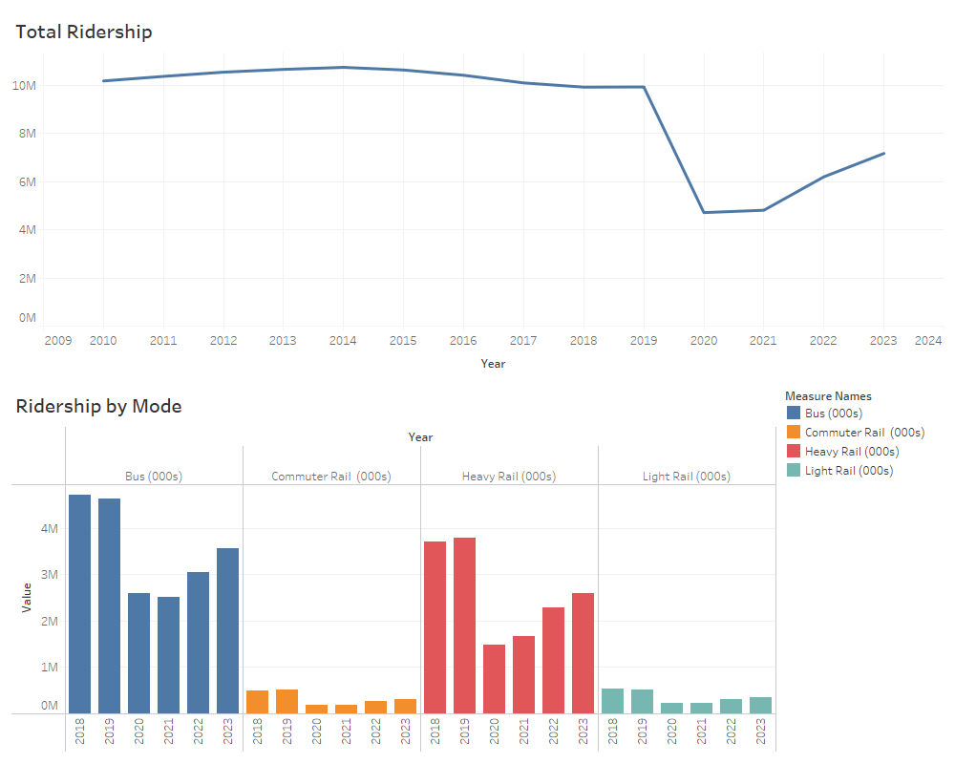
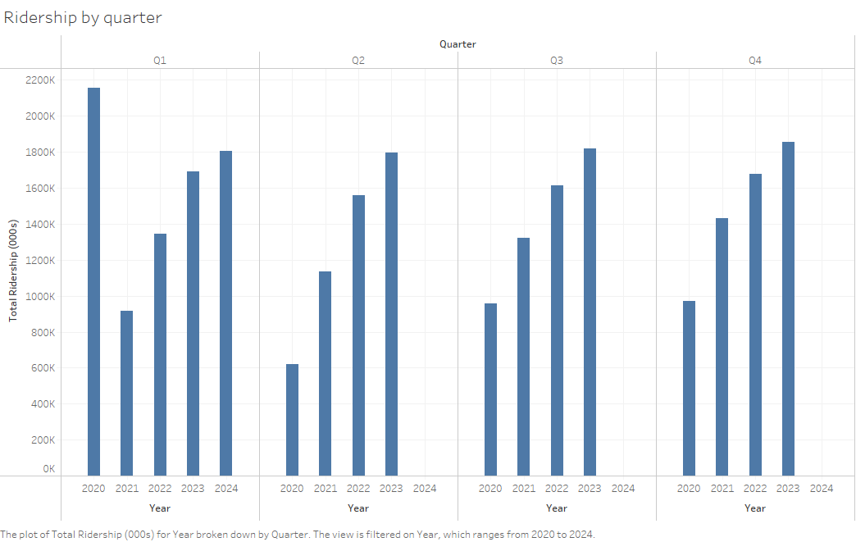
Drastic Decline and Gradual Recovery in Transit Ridership

Slide 3
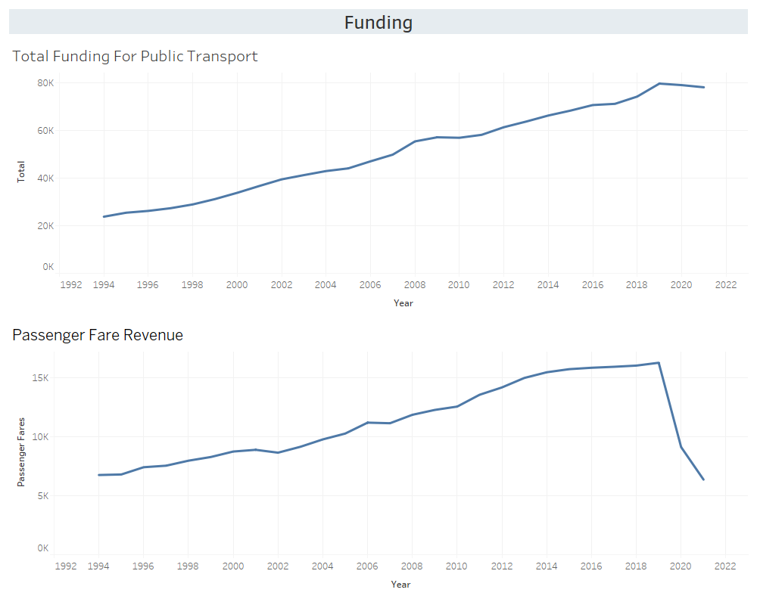
Capital and Operating Funding
"While overall funding has generally increased, passenger fare revenue suffered a substantial hit due to the pandemic."

Slide 4
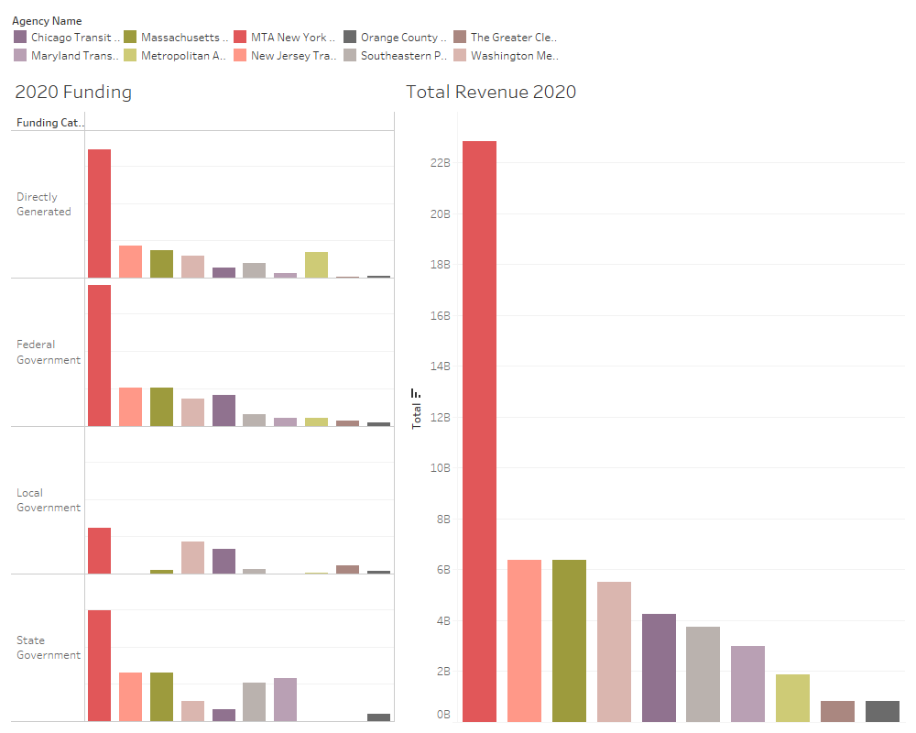
Revenue and Funding Streams
Federal government contributions were significant for many agencies in 2020, highlighting the importance of emergency funding.

